Slide 1

A Python Code on the Navier-Stokes Theorem Based on Quantum Fluids
Josef Hamilton

Slide 2

Agenda
Introduction to Navier-Stokes Theorem relating to Quantum Fluids
The Mathematical Formula for the Navier-Stokes Theorem
Solution Strategy: (Projection Method: Chorin’s Splitting)
Starting the Python code on the Navier-Stokes Theorem now…….
Import statement in the Python code
Defining Constants
The def main(): statement
The if __name__ = “__main__”: statement
The output of the Python code

Slide 3
Introduction to Navier-Stokes theorem Relating to Quantum Fluids
The Navier-Stokes Theorem is based on a set of partial differential equations which describe the motion of viscous fluid substances named after the two following physicists: Claude-Louis Navier and George Gabriel Stokes which was developed over several decades from 1822 to 1850. Navier developed his part of the Navier-Stokes Theorem in 1822 and Stokes developed his other part of the theorem from the time range of eight years from 1842 to 1850.
It mathematically expresses the momentum balance for Newtonian fluids and making use of conservation of mass. It is an equation that states pressure, density, velocity, and sometimes temperature.

Slide 4
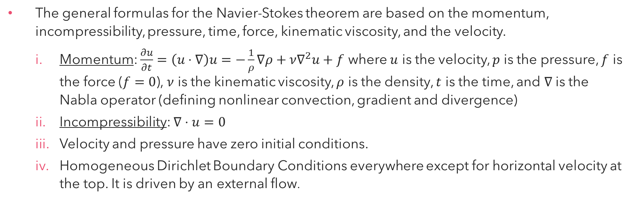
The Mathematical Formulas for the Navier-Stokes Theorem
The general formulas for the Navier-Stokes theorem are based on the momentum, incompressibility, pressure, time, force, kinematic viscosity, and the velocity.
Momentum: $\frac{∂u}{∂t}=\left(u⋅∇\right)u=−\frac{1}{ρ}∇ρ+ν∇^{2}u+f$ where $u$ is the velocity, $p$ is the pressure, $f$ is the force ($f=0$), $ν$ is the kinematic viscosity, $ρ$ is the density, $t$ is the time, and $∇$ is the Nabla operator (defining nonlinear convection, gradient and divergence)
Incompressibility: $∇⋅u=0$
Velocity and pressure have zero initial conditions.
Homogeneous Dirichlet Boundary Conditions everywhere except for horizontal velocity at the top. It is driven by an external flow.

Slide 5
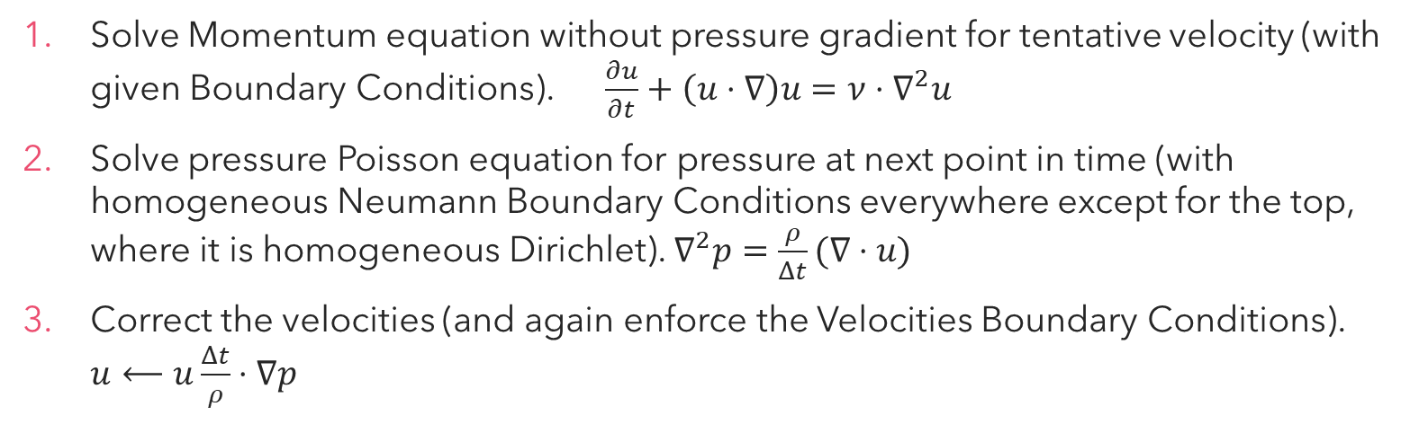
Solution Strategy: (Projection Method Chorin’s Splitting)
Solve Momentum equation without pressure gradient for tentative velocity (with given Boundary Conditions). $\frac{∂u}{∂t}+\left(u⋅∇\right)u=ν⋅∇^{2}u$
Solve pressure Poisson equation for pressure at next point in time (with homogeneous Neumann Boundary Conditions everywhere except for the top, where it is homogeneous Dirichlet). $∇^{2}p=\frac{ρ}{Δt}(∇⋅u)$
Correct the velocities (and again enforce the Velocities Boundary Conditions). $u⟵u\frac{Δt}{ρ}⋅∇p$

Slide 6

Starting the Python code on the Navier-Stokes Theorem now…..

Slide 7
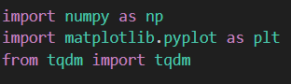
The import statements in Python
To start this Python code, we begin these three following import statements:
which are needed to be in the code for the computer to use and calculate these mathematical equations on the Navier-Stokes Theorem and sketch a graph with some plots, lines and arrows indicating the flow of the fluids in quantum fluids using the from statements import the tqdm from itself for the progress of the iterative processes giving us valuable insights into how much work have been completed and how much is remaining. The tqdm Python module comes from the Arabic word taqaddum which means progress when translated into English.

Slide 8
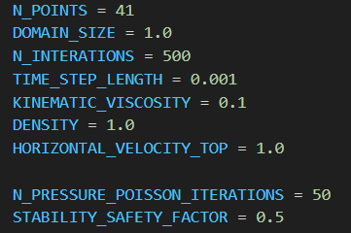
Defining Constants in Python Code
Here are all the constants defined in the Python code which will be used later in the code for use for the calculations of the Navier-Stokes Theorem in the def main(): statement:

Slide 9
The def main(): statement
The def main(): is the body of the Python code which has all the different mathematical formulas related to the Navier-Stokes Theorem written in code plus the other def statements inside that def main(): statement that do the calculations using the formulas provided, the if statements, and the plt statements as from import matplotlib.pyplot as plt (the import statements from the beginning) which sketch a graph with lines, arrows and plots, especially a diagram.

Slide 10
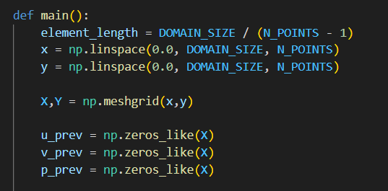
The 1st Part of the def main(): statement
The 1st part of the def main(): statement shows the pieces of Python code that explains the different variables that will be used later in this statement. Here it is:
The element_length variable is to calculate the domain size of the graph being the output and the number points plotted in the graph, x denotes the x-axis of the graph, y denotes the y-axis of the graph, the capital letters X and Y together into one variable as X,Y denotes the mesh grid plots in the graph (x,y), and the three other variables like u_prev, v_prev, and p_prev to be used for the following: solve tentative velocity + velocity BC, pressure poisson + pressure BC, and correct velocity + velocity BC

Slide 11
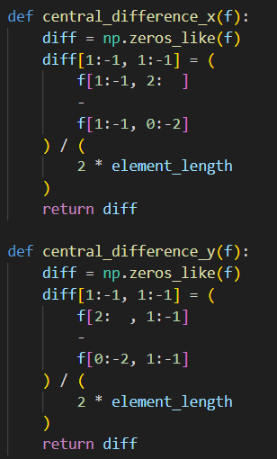
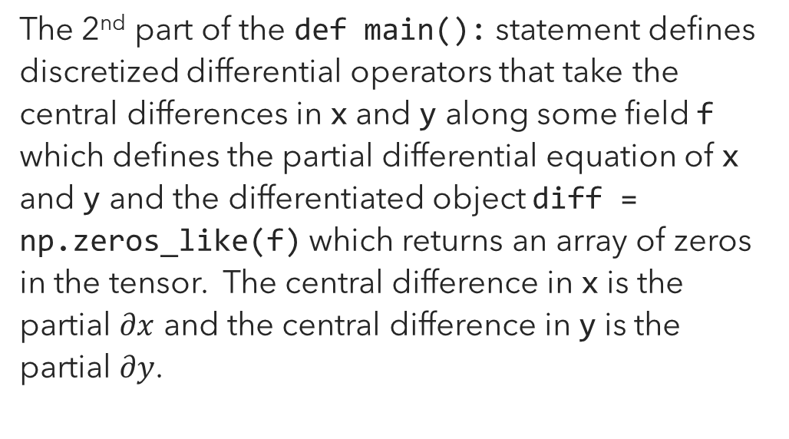
The 2nd Part of the def main(): statement
The 2nd part of the def main(): statement defines discretized differential operators that take the central differences in x and y along some field f which defines the partial differential equation of x and y and the differentiated object diff = np.zeros_like(f) which returns an array of zeros in the tensor. The central difference in x is the partial $∂x$ and the central difference in y is the partial $∂y$.

Slide 12
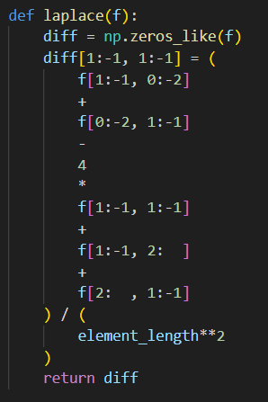
The 3rd Part of the def main(): statement
The 3rd part of the def main(): statement defines the Laplace operator which is def laplace(f): which almost does the same thing as the two other def statements but a slight change in the formula for diff[1:-1, 1:-1].

Slide 13
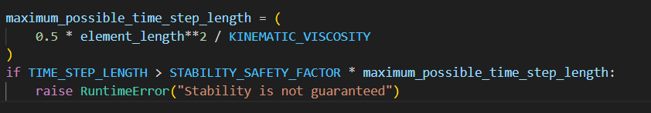
The 4th Part of the def main(): statement
The 4th part of the def main(): statement explains the mathematical formula maximum_possible_time_step_length = (0.5 * element_length**2 / KINEMATIC_VISCOSITY) which calculates the maximum time step length in Python code and the if statement showing that if the time step length is greater than this Python code equation STABILITY_SAFETY_FACTOR * maximum_possible_time_step_length, this statement prints a RuntimeError statement saying “Stability is not guaranteed”. The time step length is only limited in a certain array by a number.

Slide 14
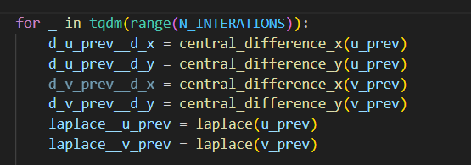
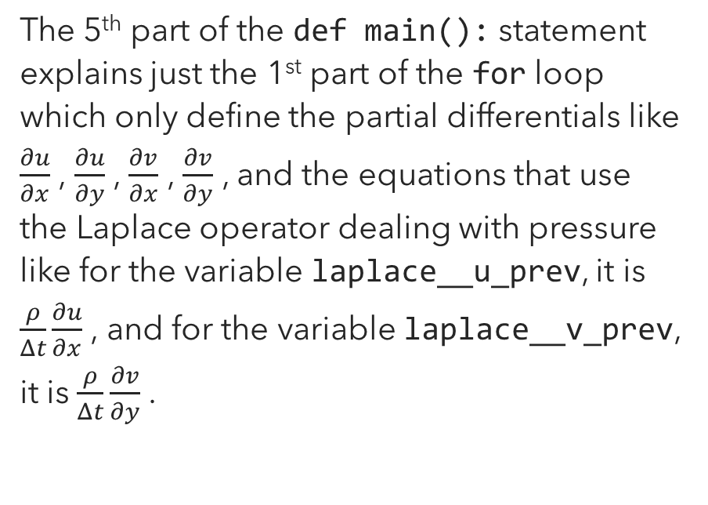
The 5th Part of the def main(): statement
The 5th part of the def main(): statement explains just the 1st part of the for loop which only define the partial differentials like $\frac{∂u}{∂x}$ , $\frac{∂u}{∂y}$ , $\frac{∂v}{∂x}$ , $\frac{∂v}{∂y}$ , and the equations that use the Laplace operator dealing with pressure like for the variable laplace__u_prev, it is $\frac{ρ}{Δt}\frac{∂u}{∂x}$ , and for the variable laplace__v_prev, it is $\frac{ρ}{Δt}\frac{∂v}{∂y}$ .

Slide 15
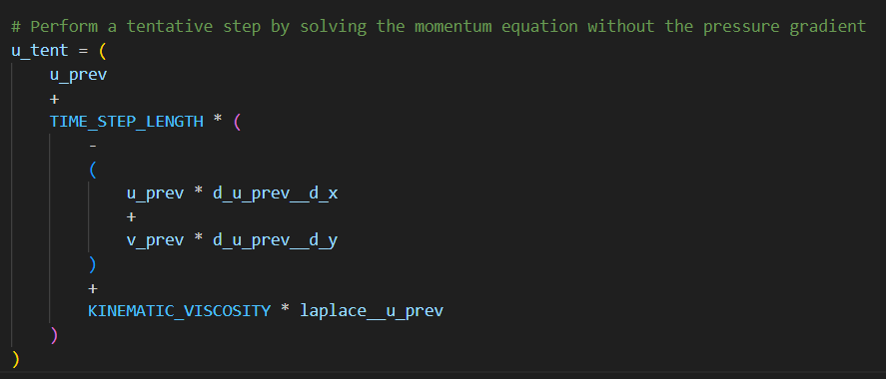
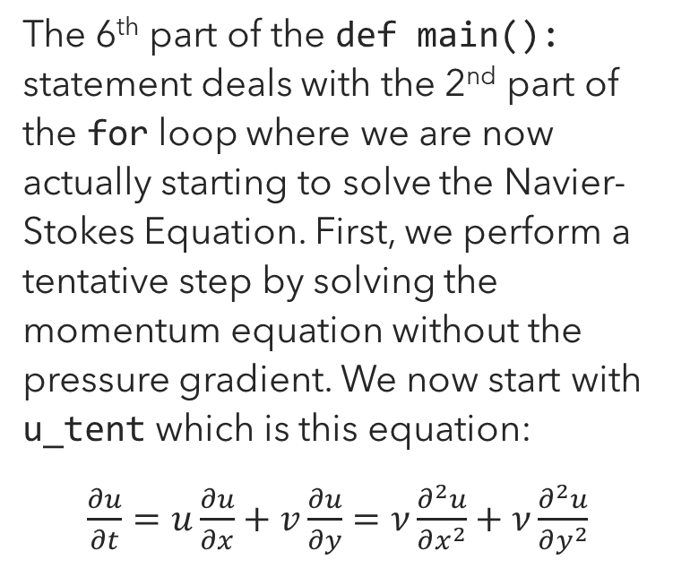
The 6th Part of the def main(): statement
The 6th part of the def main(): statement deals with the 2nd part of the for loop where we are now actually starting to solve the Navier-Stokes Equation. First, we perform a tentative step by solving the momentum equation without the pressure gradient. We now start with u_tent which is this equation:
$\frac{∂u}{∂t}=u\frac{∂u}{∂x}+v\frac{∂u}{∂y}=ν\frac{∂^{2}u}{∂x^{2}}+ν\frac{∂^{2}u}{∂y^{2}}$

Slide 16
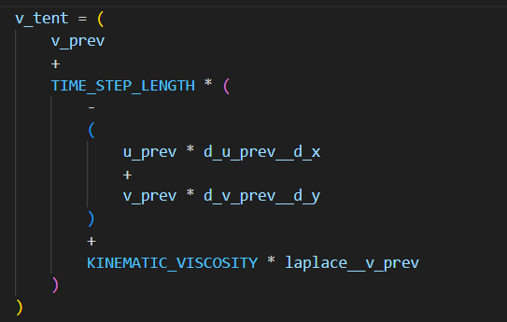
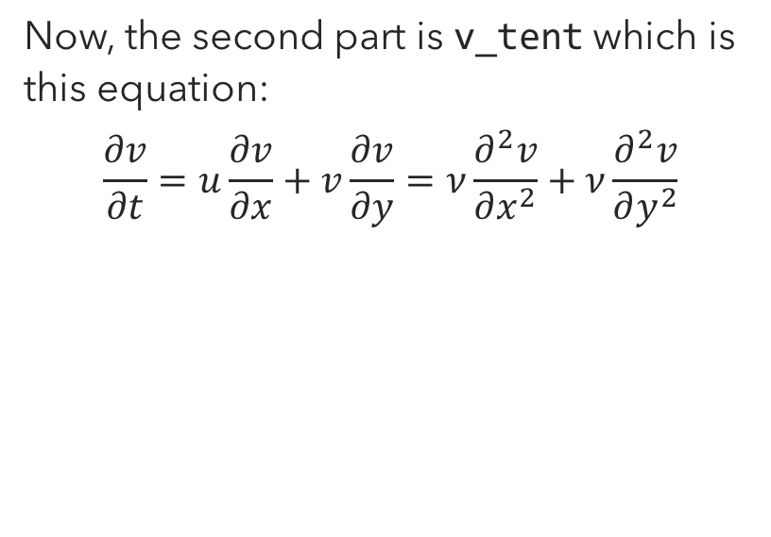
The 7th Part of the def main(): statement
Now, the second part is v_tent which is this equation:
$$\frac{∂v}{∂t}=u\frac{∂v}{∂x}+v\frac{∂v}{∂y}=ν\frac{∂^{2}v}{∂x^{2}}+ν\frac{∂^{2}v}{∂y^{2}}$$

Slide 17
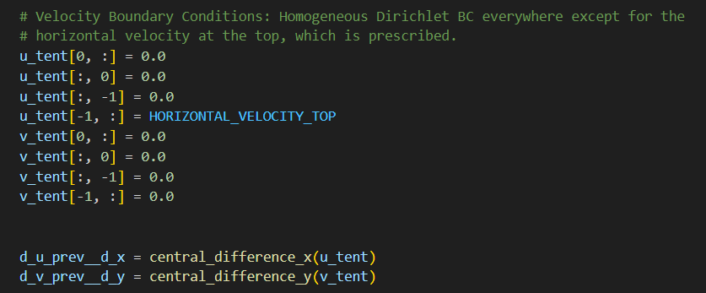
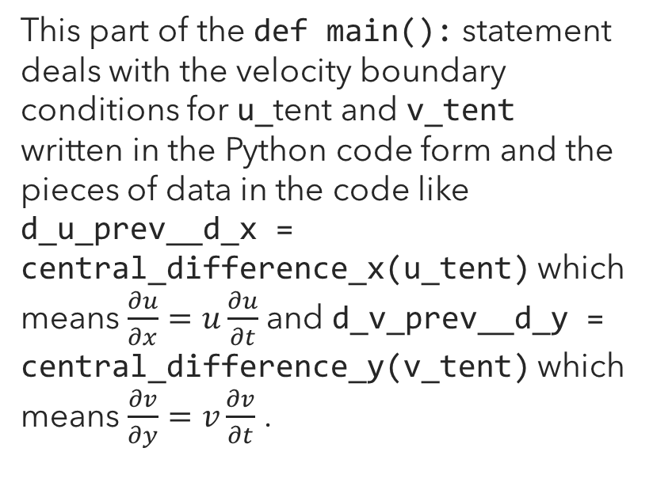
The 8th Part of the def main(): statement
This part of the def main(): statement deals with the velocity boundary conditions for u_tent and v_tent written in the Python code form and the pieces of data in the code like d_u_prev__d_x = central_difference_x(u_tent) which means $\frac{∂u}{∂x}=u\frac{∂u}{∂t}$ and d_v_prev__d_y = central_difference_y(v_tent) which means $\frac{∂v}{∂y}=v\frac{∂v}{∂t}$ .

Slide 18
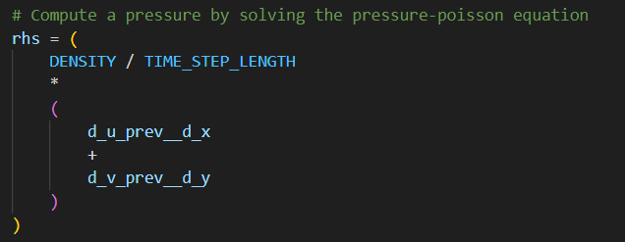
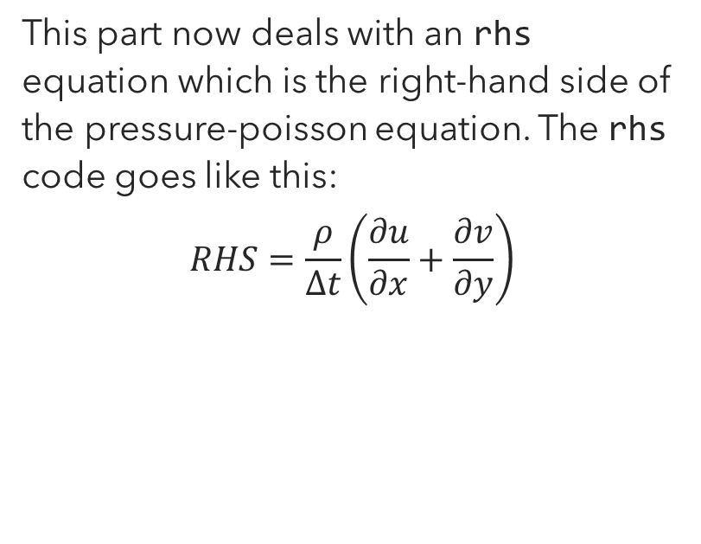
The 9th Part of the def main(): statement
This part now deals with an rhs equation which is the right-hand side of the pressure-poisson equation. The rhs code goes like this:
$$RHS=\frac{ρ}{Δt}\left(\frac{∂u}{∂x}+\frac{∂v}{∂y}\right)$$

Slide 19
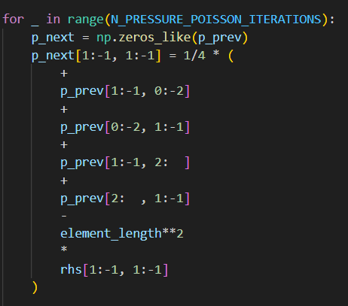
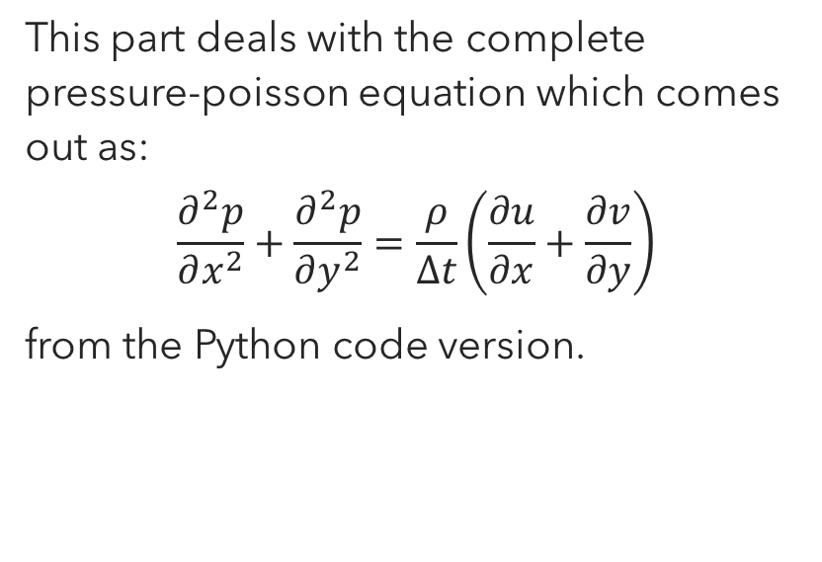
The 10th Part of the def main(): statement
This part deals with the complete pressure-poisson equation which comes out as:
$$\frac{∂^{2}p}{∂x^{2}}+\frac{∂^{2}p}{∂y^{2}}=\frac{ρ}{∆t}\left(\frac{∂u}{∂x}+\frac{∂v}{∂y}\right)$$
from the Python code version.

Slide 20
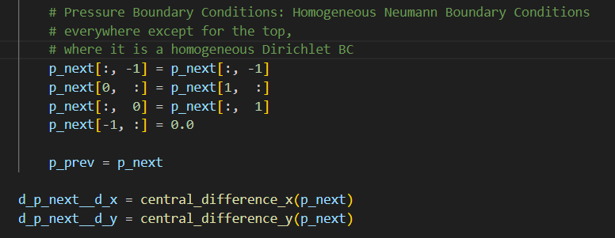
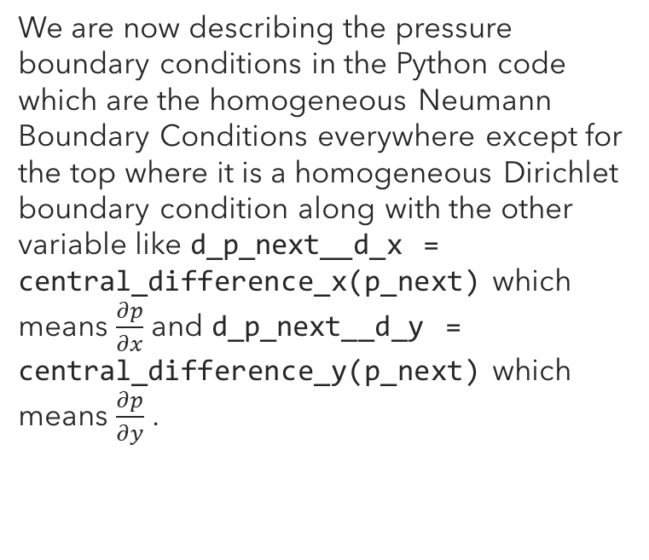
The 11th Part of the def main(): statement
We are now describing the pressure boundary conditions in the Python code which are the homogeneous Neumann Boundary Conditions everywhere except for the top where it is a homogeneous Dirichlet boundary condition along with the other variable like d_p_next__d_x = central_difference_x(p_next) which means $\frac{∂p}{∂x}$ and d_p_next__d_y = central_difference_y(p_next) which means $\frac{∂p}{∂y}$ .

Slide 21
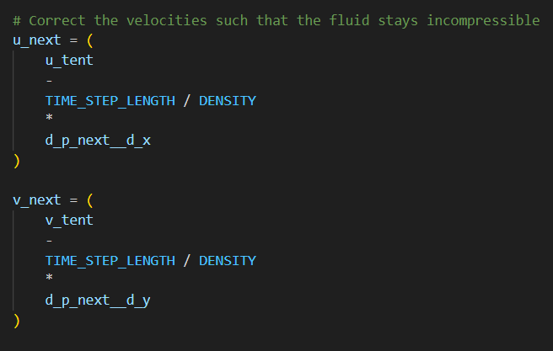
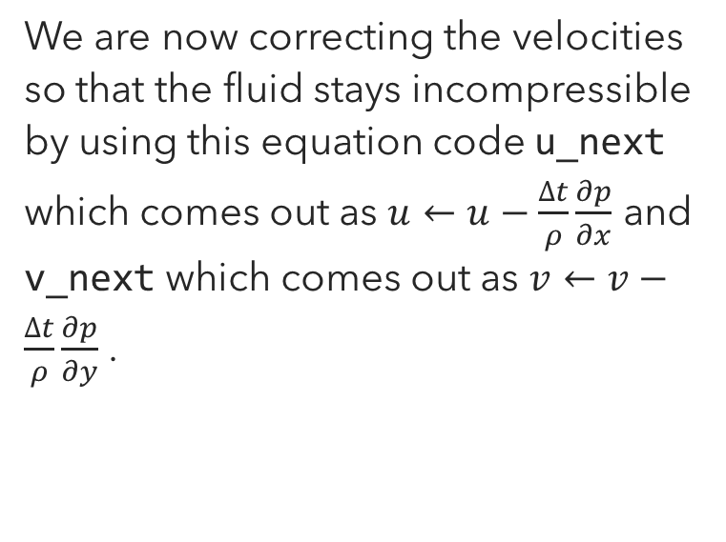
The 12th Part of the def main(): statement
We are now correcting the velocities so that the fluid stays incompressible by using this equation code u_next which comes out as $u←u−\frac{∆t}{ρ}\frac{∂p}{∂x}$ and v_next which comes out as $v←v−\frac{∆t}{ρ}\frac{∂p}{∂y}$ .

Slide 22
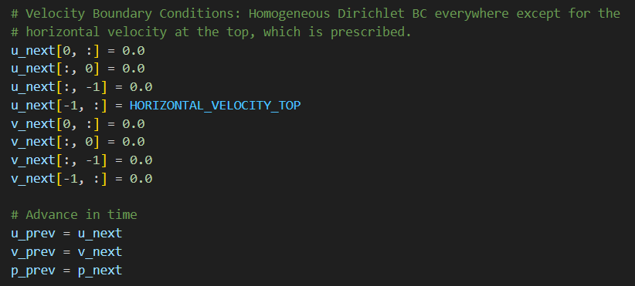
The 13th Part of the def main(): statement
This 13th part of the def main(): statement defines all the velocity boundary conditions for u_next and v_next and the advance in time.

Slide 23
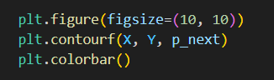
The 14th Part of the def main(): statement
The 14th part of this statement deals with plotting the graph with figure size 10 by 10, the filled contour in the range with X, Y, p_next, and the color bar which is the plt.colorbar() function which gives the graph some nice fancy colors.

Slide 24
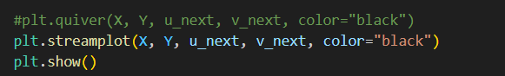
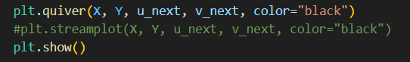
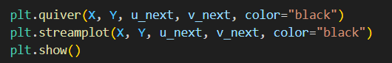
The 15th Part of the def main(): statement
These three last sets of different statements in the code are optional. They depend on how we want the graph to come out when we run this code. The plt.streamplot(X, Y, u_next, v_next, color=“black”) prints out lines and arrows while the plt.quiver(X, Y, u_next, v_next, color=“black”) prints out the small arrows pointing and spinning around the graph. We can use both statements at the same time and run the code to get a result in the graph that is different from the first two sets of different statements.

Slide 25
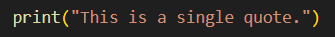
The 16th Part of the def main(): statement
Finally, the last part of the def main(): statement is the print statement which prints this statement in quote that we will see in the terminal in Microsoft Visual Studio which says, “This is a single quote.”.

Slide 26
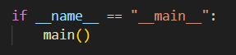
The if __name__ == “__main__”: statement
The if __name__ == “__main__”: statement with the main() function is the main switch where the file is only executed within the Python interpreter.

Slide 27
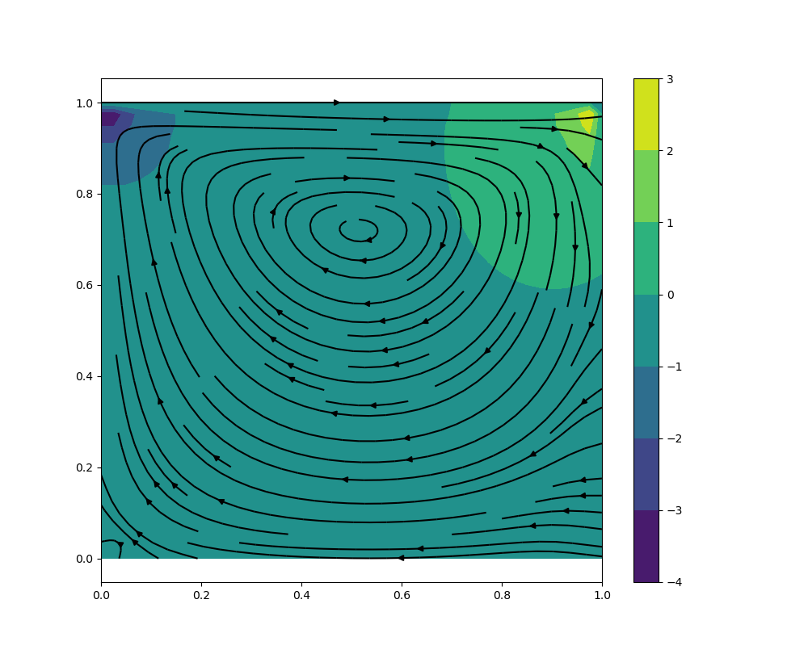
The Results of this Python Code (Part 1)
This is the final output of this code when using the plt.streamplot function.

Slide 28
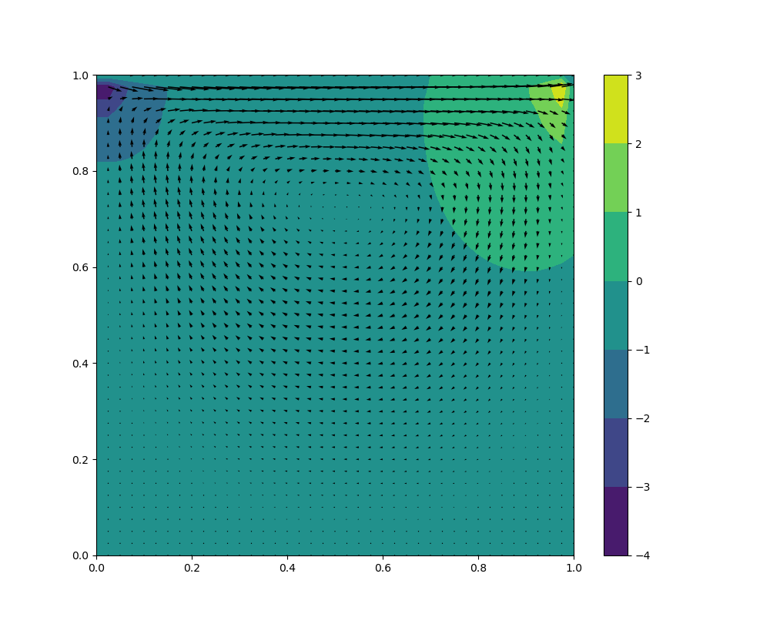
The Results of this Python Code (Part 2)
This is the final output of this code when using the plt.quiver function.

Slide 29
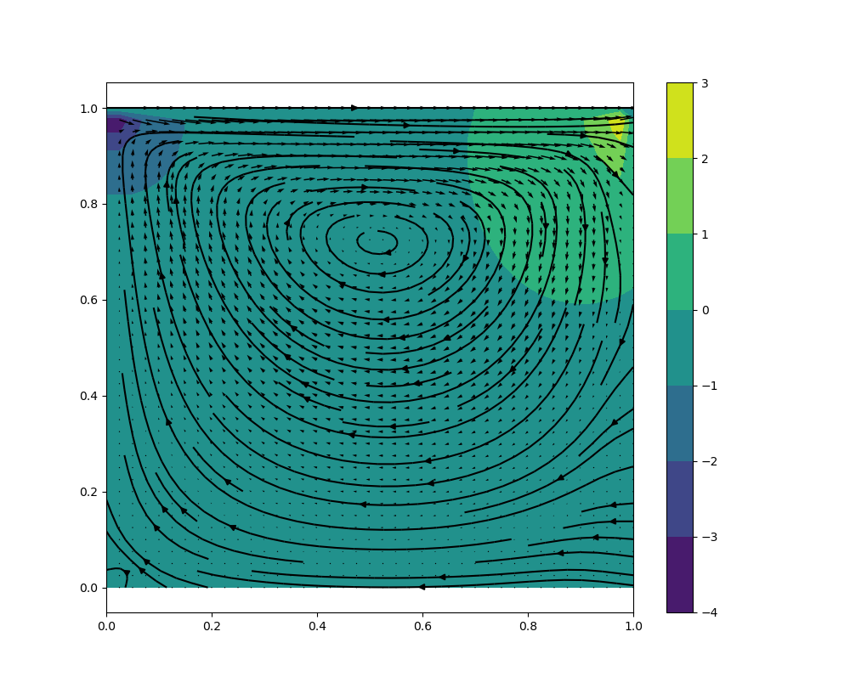
The Results of this Python Code (Part 3)
This is the final output of this code when using both the plt.streamplot function and the plt.quiver function together.

Slide 30

Thank You.

